Slide 1
Backbone Questionnaires

Slide 2
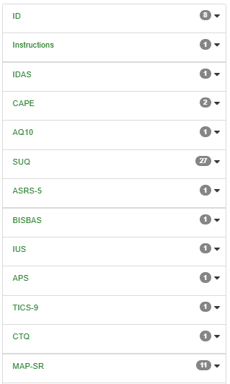
Adults Questionnaire
ID: ID & Projekt
Instructions: eben dies
IDAS: Inventory of Depression and Anxiety Symptoms
CAPE: Community Assessment of Psychic Experiences
AQ10: Autismus screening
SUQ: Substance use questionnaire
ASRS-5: ADHS Screening
BISBAS: Behavioral Approach and Behavioral Inhibition System Evaluation
IUS: Intolerance of Uncertainty Scale
APS: Arousal Predisposition Scale
TICS-9: Trier Inventory for Chronic Stress
CTQ: Childhood Trauma Questionnaire
MAP-SR: Motivation and Pleasure Scale

Slide 3
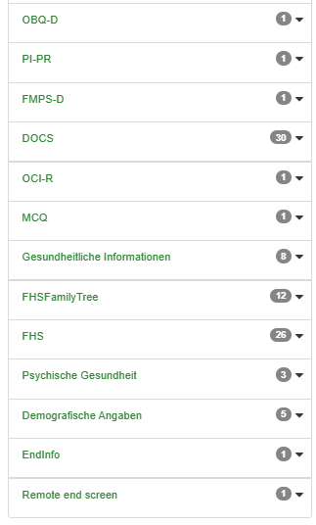
Only Project 9
OBQ-ID: Obsessive Beliefs Questionnaire
PI-PR: Padua Inventory Palatine Revision – OCD Symptom Dimensions
FMPS-D: Frost Multidimensional Perfectionism Scale-Deutsch
DOCS: Dimensional Obsessive-Compulsive Scale
OCI-R: Obsessional Compulsive Inventory
MCQ: Metacognitition Scale
Gesundheitliche Informationen:
FHSFamily Tree: Mental Health in Family
FHS: Mental Health in Family
Psychische Gesundheit:
Demographische Angaben: Alter, Geschlecht, Bildung, usw.

Slide 4
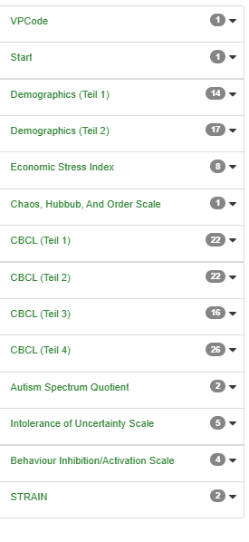
Project 6
Custom „Backbone“ – eigentklich nur Autism, IUS und BIS/BAS gleich

